Slide 1

AutoCAD
AUTODESK
COURSE SLIDES · NON-WSQ COURSE
AutoCAD Masterclass
Course Code: C391
Conducted by Tertiary Infotech Academy Pte Ltd · UEN 201200696W
Version v1.0 · 1 October 2026
© 2026 Tertiary Infotech Academy Pte Ltd. All rights reserved. · www.tertiarycourses.com.sg

Slide 2
COURSE ADMINISTRATION
Welcome & Housekeeping
AutoCAD Masterclass · C391
© 2026 Tertiary Infotech Academy Pte Ltd
2

Slide 3
YOUR TRAINER · TEMPLATE
About the Trainer
NAME
____________________________________________
TP
TITLE / DESIGNATION
____________________________________________
QUALIFICATIONS
____________________________________________
Trainer Profile Template
AREAS OF EXPERTISE
____________________________________________
Complete before delivery
TRAINING & INDUSTRY EXPERIENCE
____________________________________________
CONTACT
____________________________________________
AutoCAD Masterclass · C391
© 2026 Tertiary Infotech Academy Pte Ltd
3

Slide 4
YOUR TRAINER
About the Trainer
ROLE
Principal Trainer, Tertiary Infotech Academy Pte Ltd
AA
SPECIALISATION
CAD, technical drawing and engineering design — AutoCAD, Revit and Fusion 360.
Dr Alfred Ang
DELIVERS
Courses on technical drawing, design and emerging technologies.
Principal Trainer
Tertiary Infotech Academy Pte Ltd
FOUNDER
Founder and lead instructor at Tertiary Infotech / Tertiary Courses.
AutoCAD Masterclass · C391
© 2026 Tertiary Infotech Academy Pte Ltd
4

Slide 5
ICE-BREAKER
Let's Know Each Other
• Your name and organisation / role.
• Your experience with CAD, drafting or design (if any).
• What you want to be able to draw or document after this course.
AutoCAD Masterclass · C391
© 2026 Tertiary Infotech Academy Pte Ltd
5

Slide 6
HOUSEKEEPING
Ground Rules
Set your mobile phone to silent mode.
Participate actively — no question is stupid.
1
2
Mutual respect: agree to disagree.
One conversation at one time.
3
4
Be punctual; return from breaks on time.
Attend both days in full.
5
6
AutoCAD Masterclass · C391
© 2026 Tertiary Infotech Academy Pte Ltd
6

Slide 7

COURSE PORTAL · LMS/TMS
Download Course Material
• Log in to the LMS/TMS portal with the account created at registration.
• Portal: https://lms-tms.tertiaryinfotech.com
• Open your course → Course Materials to download the slides and Learner Guide.
• Keep them handy — refer to the slides and Learner Guide during the labs.
AutoCAD Masterclass · C391
© 2026 Tertiary Infotech Academy Pte Ltd
7

Slide 8
SCHEDULE
Lesson Plan — 2 Days, 7.5 hours/day
Day 1
Day 2
• Day 1 — AutoCAD Foundations, Drawing & Modifying Objects
– Welcome · introductions · course overview
– Topic 1: Getting Started with AutoCAD (Lab 1)
– Topic 2: Technical Drawing with AutoCAD (Labs 2–5)
– Topic 3: Modifying Objects (Labs 6–8)
• Day 2 — Organizing Objects & Design Documentation
– Topic 4: Organizing Objects (Labs 9–12)
– Topic 5: Design Documentation (Labs 13–16)
– Course summary & feedback
– Daily timing: 9:30am–5:30pm · 30-min lunch
AutoCAD Masterclass · C391
© 2026 Tertiary Infotech Academy Pte Ltd
8

Slide 9
FIVE TOPICS · 16 HANDS-ON LABS
Course Outline
Day 1
Day 2
• Topic 1: Getting Started with AutoCAD
– AutoCAD user interface
– Workspace settings, navigation and units
• Topic 2: Technical Drawing with AutoCAD
– Basic AutoCAD operations
– Drawing objects and isometric drawing
• Topic 3: Modifying Objects
– Working with modifiers: move, copy, trim, arrays…
• Topic 4: Organizing Objects
– Object properties and layers
– Blocks, attributes and reusable content
• Topic 5: Design Documentation
– Text, dimensions and part-list tables
– Layouts, printing and outputs
– Annotative techniques
AutoCAD Masterclass · C391
© 2026 Tertiary Infotech Academy Pte Ltd
9

Slide 10
CORE CONCEPTS
Technical Drawing & CAD Fundamentals
AutoCAD Masterclass · C391
© 2026 Tertiary Infotech Academy Pte Ltd
10

Slide 11
STANDARDS, CONVENTIONS & TYPES
What is a Technical Drawing?
Precise communication
A technical drawing communicates a design's exact geometry, sizes and finishes for manufacture or construction.
Standards-based
Symbols, line conventions, projections and dimensioning follow standards (ISO/ANSI) so any reader interprets it the same way.
1
2
Types
Orthographic multi-view, isometric/pictorial, section, detail and assembly drawings — each answers a different question.
CAD advantage
AutoCAD makes drawings precise, editable, layered, reusable and printable at any scale.
3
4
AutoCAD Masterclass · C391
© 2026 Tertiary Infotech Academy Pte Ltd
11

Slide 12
METHODOLOGY
The Technical Drawing Workflow
Set up & draw
Organise & refine
Document & publish
• Template, units and limits
• Precision aids: snap, ortho, polar
• Draw geometry at 1:1
• Layers, properties, blocks
• Modify: trim, fillet, array
• Attributes for part data
• Dimensions, text and tables
• Layouts with scaled viewports
• Plot to PDF for submission
AutoCAD Masterclass · C391
© 2026 Tertiary Infotech Academy Pte Ltd
12

Slide 13
01
TOPIC 01
Getting Started with AutoCAD
AutoCAD User Interface · Workspace Settings · Navigation · Units
AutoCAD Masterclass · C391
© 2026 Tertiary Infotech Academy Pte Ltd
13

Slide 14
TOPIC 01 · KEY CONCEPTS
Key Concepts — Getting Started with AutoCAD
User interface
Application menu, Quick Access Toolbar, ribbon tabs and panels, drawing area, command window and status bar.
Workspaces
Drafting & Annotation, 3D Basics and 3D Modeling — task-oriented sets of ribbons, menus and palettes.
1
2
Model vs paper space
Design at 1:1 in model space; compose scaled drawing sheets in paper-space layouts.
Precision aids
Grid and snap, ortho mode, polar tracking, object snaps and dynamic input keep every pick exact.
3
4
Navigation
Zoom, pan, ViewCube and the wheel mouse move you around a drawing without changing it.
Units and limits
UNITS sets the length/angle format and precision; LIMITS frames the working area of the drawing.
5
6
AutoCAD Masterclass · C391
© 2026 Tertiary Infotech Academy Pte Ltd
14

Slide 15
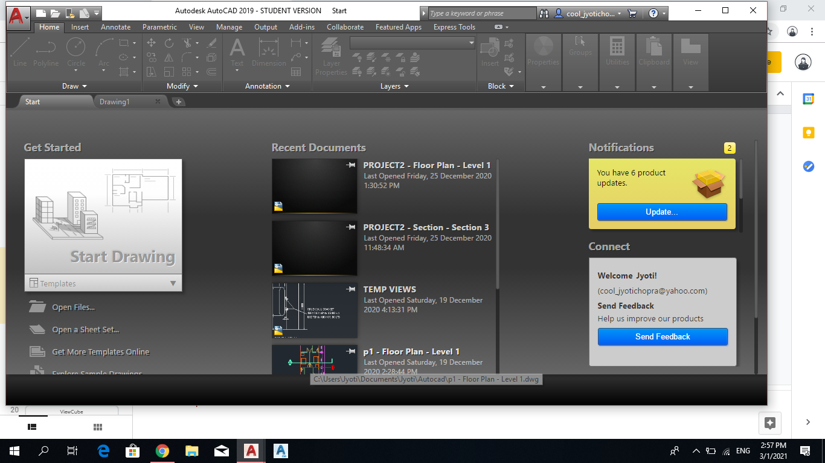
USER INTERFACE
AutoCAD User Interface — Application Menu
• The Application button opens the file-level menu: create, open and save drawings.
• Audit, recover and purge a drawing file when it needs repair or cleanup.
• Print or publish a file, and access the Options dialog for system settings.
• Recent documents are listed for quick reopening.
AutoCAD Masterclass · C391
© 2026 Tertiary Infotech Academy Pte Ltd
15

Slide 16
USER INTERFACE
Starting a New Drawing
• Start New Drawing creates a file from the default drawing template (DWT).
• Metric drawings use acadiso.dwt; imperial drawings use acad.dwt.
• The default template is set in the Options dialog.
• Templates carry units, styles, layers and title blocks — start right, draw less.
AutoCAD Masterclass · C391
© 2026 Tertiary Infotech Academy Pte Ltd
16

Slide 17
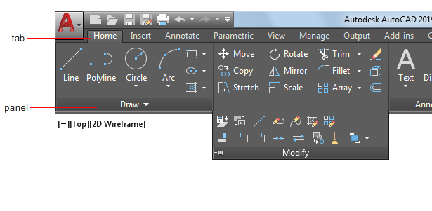
USER INTERFACE
Ribbon Tabs and Panels
• The ribbon organises tools into tabs (Home, Insert, Annotate, View, Output…).
• Each tab is a set of panels — Draw, Modify, Layers, Annotation and more.
• Panels expand to reveal less-used tools; pin them open while learning.
• Most course commands live on the Home tab's Draw and Modify panels.
AutoCAD Masterclass · C391
© 2026 Tertiary Infotech Academy Pte Ltd
17

Slide 18
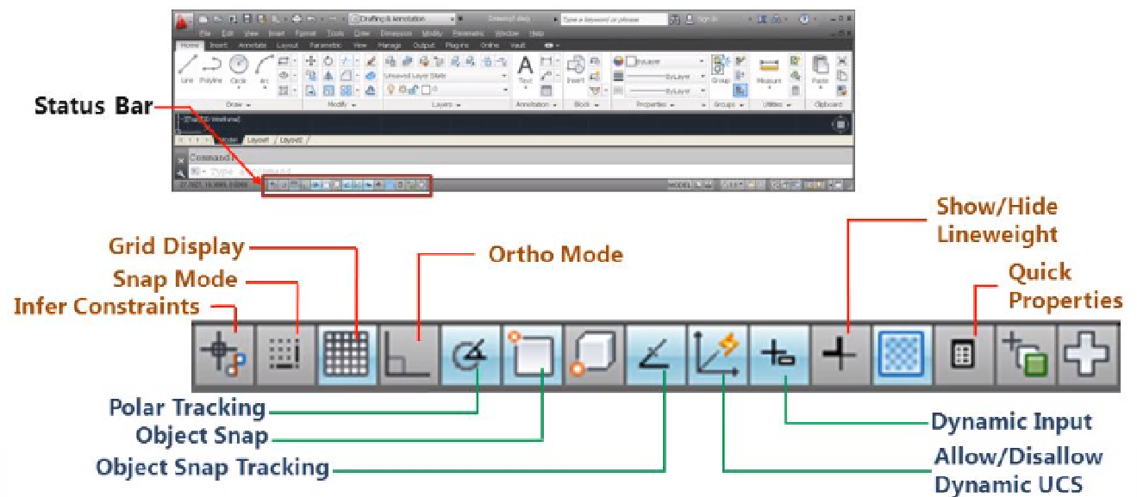
USER INTERFACE
Status Bar — Precision Drafting Aids
• The status bar toggles grid, snap, ortho, polar tracking and object snap.
• Ortho constrains the cursor to horizontal/vertical; Polar tracks set angles.
• 2D object snap picks exact endpoints, midpoints, centres and intersections.
• Function keys mirror the toggles: F7 grid · F8 ortho · F9 snap · F10 polar · F3 osnap.
AutoCAD Masterclass · C391
© 2026 Tertiary Infotech Academy Pte Ltd
18

Slide 19
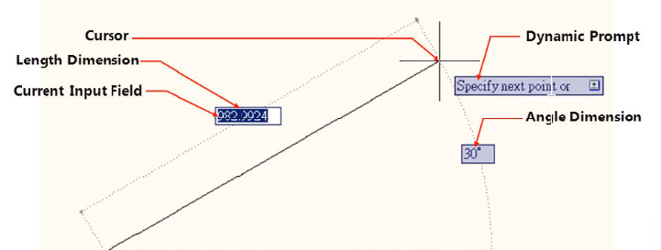
USER INTERFACE
Dynamic Input and the Command Window
• Dynamic input places a command interface beside the cursor as you draw.
• Tooltips show prompts, dimensions and coordinate entry at the crosshair.
• The command window (Ctrl+9) accepts commands and shows every prompt.
• Watch the prompts — AutoCAD always tells you what it expects next.
AutoCAD Masterclass · C391
© 2026 Tertiary Infotech Academy Pte Ltd
19

Slide 20
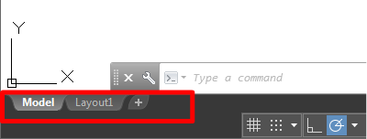
WORKSPACE
Model Space and Paper Space
• Model space is where you design — always draw at 1:1 real-world size.
• Paper space (layouts) is where you compose scaled sheets for printing.
• The UCS icon shows the origin and orientation of the coordinate system.
• Switch between them with the Model and Layout tabs below the drawing area.
AutoCAD Masterclass · C391
© 2026 Tertiary Infotech Academy Pte Ltd
20

Slide 21
WORKSPACE
Workspaces and the Quick Access Toolbar
• Workspaces group menus, toolbars and ribbons for a task: Drafting & Annotation, 3D Basics, 3D Modeling.
• This course uses Drafting & Annotation throughout.
• The Quick Access Toolbar sits top-left: New, Open, Save, Undo, Plot.
• Right-click any ribbon tool → Add to Quick Access Toolbar to customise it.
AutoCAD Masterclass · C391
© 2026 Tertiary Infotech Academy Pte Ltd
21

Slide 22

NAVIGATION
Navigation — Zoom, Pan and the Wheel Mouse
• The navigation bar provides Pan and the full set of Zoom tools.
• ZOOM (Z): Window, All, Extents, Previous, Scale, Object — know them all.
• Wheel mouse: scroll to zoom, press to pan, double-click to zoom extents.
• Navigation changes your view only — it never moves the geometry.
AutoCAD Masterclass · C391
© 2026 Tertiary Infotech Academy Pte Ltd
22

Slide 23
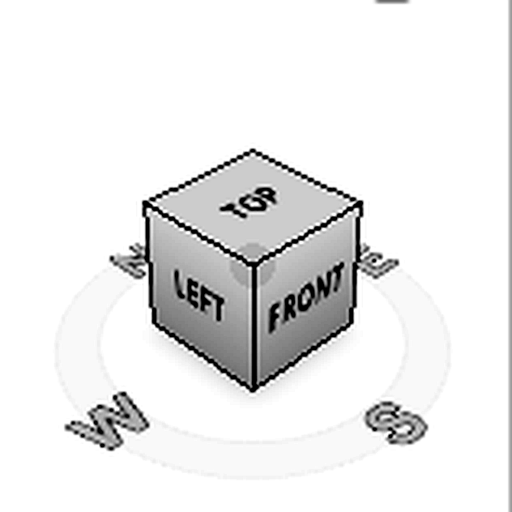
NAVIGATION
ViewCube and 2D/3D Views
• The ViewCube switches between standard and isometric views of the model.
• Click a face, edge or corner to jump to that view; drag to orbit freely.
• Set Current View as Home to return to a saved orientation.
• In 2D drafting you will mostly stay on the Top view.
AutoCAD Masterclass · C391
© 2026 Tertiary Infotech Academy Pte Ltd
23

Slide 24
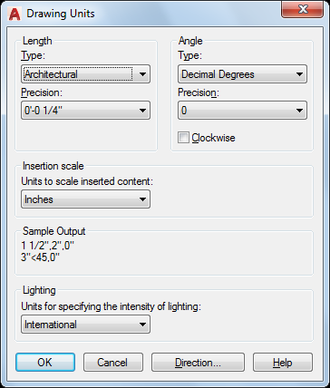
SETUP
Drawing Units and Converting Units
• UNITS sets the length type (Decimal, Architectural, Engineering…) and precision.
• Angles default to decimal degrees measured anticlockwise from east.
• This course draws in millimetres with decimal units.
• To convert a drawing's scale: SCALE → All → base 0,0 → factor (e.g. 25.4).
AutoCAD Masterclass · C391
© 2026 Tertiary Infotech Academy Pte Ltd
24

Slide 25
TOPIC 01 · HANDS-ON
Setting Up a New Drawing
LAB 1
Create and verify a metric drawing environment, compare saved workspace and drafting-setting examples, then open a finished drawing and practise reading it with zoom, pan and ViewCube.
You'll produce
A correctly configured metric drawing saved as DWG, a settings audit, and confident navigation of an existing technical drawing.
Commands: ACADISO template, UNITS, LIMITS, DSETTINGS, WSCURRENT, ZOOM, PAN, ViewCube
Files: lab01-table.dwg
AutoCAD Masterclass · C391
© 2026 Tertiary Infotech Academy Pte Ltd
25

Slide 26
LAB 1 · VERIFY
Setting Up a New Drawing
✅ Check your work
INSUNITS reports millimetres, limits are 420 × 297, Drafting & Annotation is current, the precision-aid audit is complete, and lab01-setup.dwg reopens with the settings intact.
AutoCAD Masterclass · C391
© 2026 Tertiary Infotech Academy Pte Ltd
26

Slide 27
TOPIC RECAP
Recap — Getting Started with AutoCAD
Lab 1 — Setting Up a New Drawing
A correctly configured metric drawing saved as DWG, a settings audit, and confident navigation of an existing technical drawing.
1
AutoCAD Masterclass · C391
© 2026 Tertiary Infotech Academy Pte Ltd
27

Slide 28
02
TOPIC 02
Technical Drawing with AutoCAD
Basic AutoCAD Operations · Drawing Objects · Isometric Drawing
AutoCAD Masterclass · C391
© 2026 Tertiary Infotech Academy Pte Ltd
28

Slide 29
TOPIC 02 · KEY CONCEPTS
Key Concepts — Technical Drawing with AutoCAD
Lines & polylines
LINE draws separate segments; PLINE creates one connected object of line and arc segments.
Circles & arcs
Circles by centre/radius or diameter; arcs by combinations of start, centre, end, radius and angle.
1
2
Rectangles & polygons
RECTANG builds closed rectangular polylines; POLYGON draws 3–1024-sided regular polygons.
Ellipses, splines & points
Ellipses from axis endpoints; splines as smooth curves through fit points; points as snap nodes.
3
4
Construction geometry
Construction lines (XLINE) and rays give infinite reference lines for projecting views.
2D isometric drawing
ISODRAFT turns on isometric planes so a flat drawing represents a 3D projection.
5
6
AutoCAD Masterclass · C391
© 2026 Tertiary Infotech Academy Pte Ltd
29

Slide 30
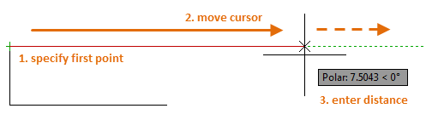
DRAWING OBJECTS
Lines
• LINE draws straight segments between picked or typed points.
• Specify the first point, then each next point; every segment is a separate object.
• Combine with object snaps and grid snap for exact geometry.
• Coordinate entry: absolute (100,50) · relative (@50,0) · polar (@50<30).
AutoCAD Masterclass · C391
© 2026 Tertiary Infotech Academy Pte Ltd
30

Slide 31
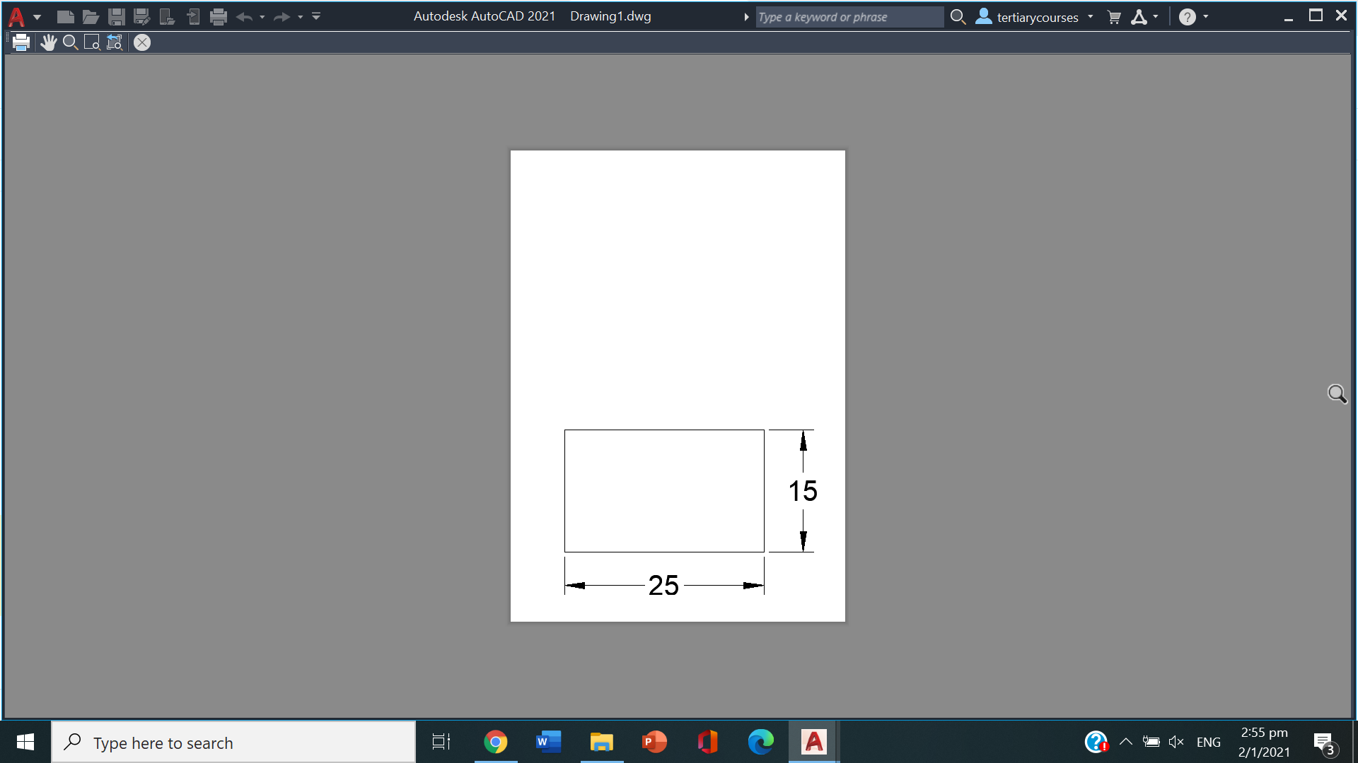
DRAWING OBJECTS
Circles and Rectangles
• CIRCLE: centre + radius or diameter; 2P/3P through points; TTR tangent-tangent-radius.
• RECTANG creates a closed rectangular polyline from two corners.
• Rectangle options add chamfered or filleted corners and a set width.
• Use dimensions option (@length,width) for exact rectangle sizes.
AutoCAD Masterclass · C391
© 2026 Tertiary Infotech Academy Pte Ltd
31

Slide 32
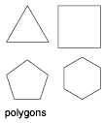
DRAWING OBJECTS
Polygons and Ellipses
• POLYGON draws regular polygons of 3–1024 sides.
• Inscribed polygons fit inside the reference circle; circumscribed fit outside.
• ELLIPSE uses two axis endpoints then the half-width of the other axis.
• An elliptical arc is an ellipse with start and end angles.
AutoCAD Masterclass · C391
© 2026 Tertiary Infotech Academy Pte Ltd
32

Slide 33
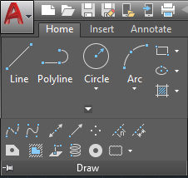
DRAWING OBJECTS
Arcs, Polylines and Splines
• ARC draws by combinations of start, centre, end, radius, angle and direction.
• PLINE creates one object of connected line and arc segments — switch modes as you draw.
• SPLINE fits a smooth curve through or near a set of fit points.
• Closed polylines are the basis for hatching, areas and 3D operations.
AutoCAD Masterclass · C391
© 2026 Tertiary Infotech Academy Pte Ltd
33

Slide 34
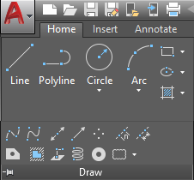
CONSTRUCTION GEOMETRY
Points, Construction Lines and Rays
• POINT places node objects; PDMODE and PDSIZE control how they display.
• Points act as snap nodes — DIVIDE and MEASURE place them along objects.
• XLINE creates infinite construction lines for projecting between views.
• RAY starts at a point and extends infinitely in one direction.
AutoCAD Masterclass · C391
© 2026 Tertiary Infotech Academy Pte Ltd
34

Slide 35
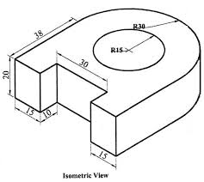
ISOMETRIC
2D Isometric Drawing with ISODRAFT
• A 2D isometric drawing is a flat representation of a 3D isometric projection.
• ISODRAFT switches the crosshairs to the isometric axes (30°/90°/150°).
• F5 cycles the three isoplanes: Top, Right and Left.
• Isocircles (ELLIPSE → Isocircle) draw round features on the active isoplane.
AutoCAD Masterclass · C391
© 2026 Tertiary Infotech Academy Pte Ltd
35

Slide 36
WHAT YOU'LL DO
Hands-On Labs — Technical Drawing with AutoCAD
Labs 2–3
Lab 4
Lab 5
• Creating Lines and Coordinates
• Circles, Rectangles and Polygons
• Polylines, Arcs, Ellipses and Splines
• 2D Isometric Drawing
AutoCAD Masterclass · C391
© 2026 Tertiary Infotech Academy Pte Ltd
36

Slide 37
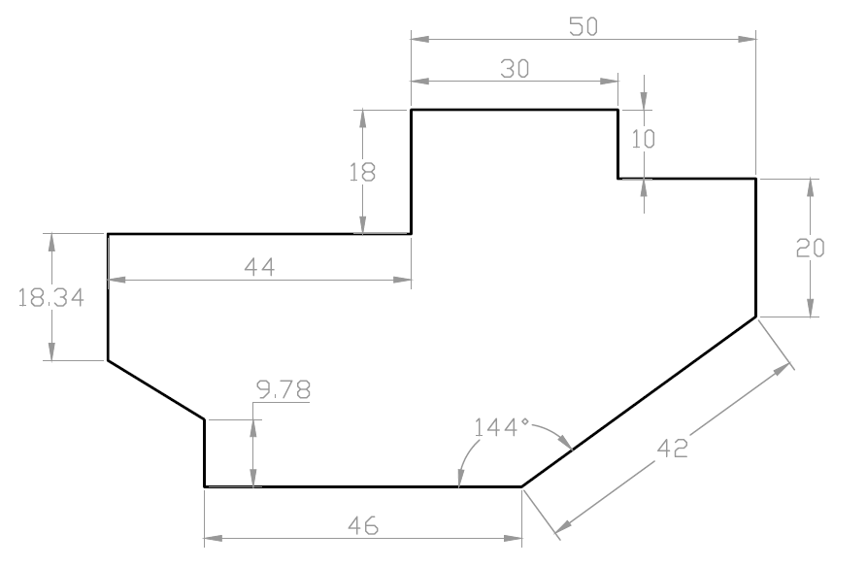
TOPIC 02 · HANDS-ON
Creating Lines and Coordinates
LAB 2
Draw the outline of practice drawing EX-1 using the LINE and PLINE commands with absolute, relative and polar coordinate entry, working from its dimensioned drawing sheet.
You'll produce
The completed EX-1 profile drawn to size, matching the supplied solution DWG.
Commands: LINE, PLINE, coordinate entry (@dx,dy · @dist<angle), ORTHO, dynamic input
Files: ex1.dwg
AutoCAD Masterclass · C391
© 2026 Tertiary Infotech Academy Pte Ltd
37

Slide 38
LAB 2 · VERIFY
Creating Lines and Coordinates
✅ Check your work
Your outline closes exactly (LIST shows the final vertex at 0,0) and overlays the solution ex1.dwg with no visible deviation.
AutoCAD Masterclass · C391
© 2026 Tertiary Infotech Academy Pte Ltd
38

Slide 39
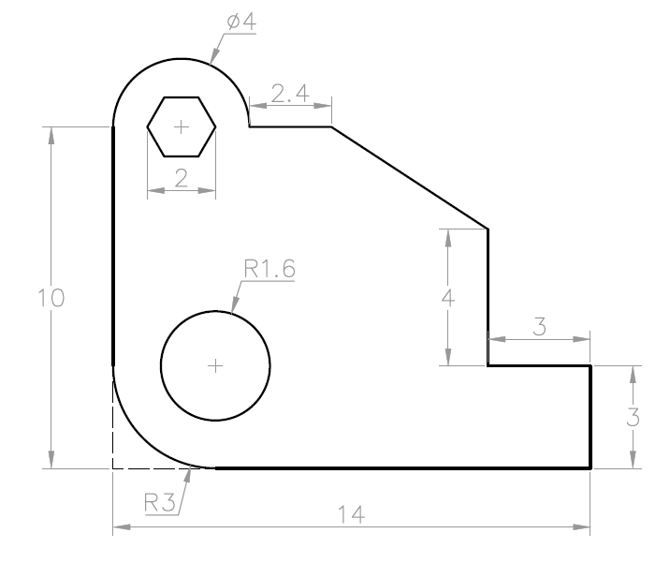
TOPIC 02 · HANDS-ON
Circles, Rectangles and Polygons
LAB 3
Complete practice drawing EX-2 by adding circles (centre-radius, diameter, 2P/3P and Tan-Tan-Radius), a rectangle with chamfered/filleted corners and inscribed/circumscribed polygons.
You'll produce
The completed EX-2 drawing with all holes, rectangles and polygons placed to the sheet dimensions.
Commands: CIRCLE (Cen-Rad, 2P, 3P, TTR), RECTANG, POLYGON, object snaps
Files: ex2.dwg
AutoCAD Masterclass · C391
© 2026 Tertiary Infotech Academy Pte Ltd
39

Slide 40
LAB 3 · VERIFY
Circles, Rectangles and Polygons
✅ Check your work
Every circle's centre and radius match the sheet (use LIST), the hexagon has 6 equal sides, and your drawing overlays ex2.dwg cleanly.
AutoCAD Masterclass · C391
© 2026 Tertiary Infotech Academy Pte Ltd
40

Slide 41
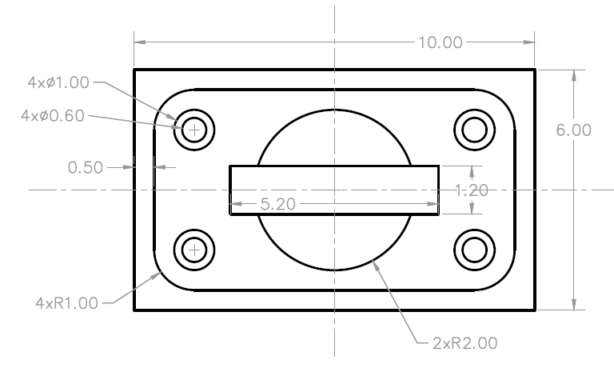
TOPIC 02 · HANDS-ON
Polylines, Arcs, Ellipses and Splines
LAB 4
Draw practice drawing EX-3 combining polylines with arc segments, standalone arcs, an ellipse and a spline, plus construction lines to project feature positions between views.
You'll produce
The completed EX-3 drawing with mixed line/arc geometry drawn as clean, connected objects.
Commands: PLINE (Arc mode), ARC, ELLIPSE, SPLINE, XLINE, POINT/DIVIDE
Files: ex3.dwg
AutoCAD Masterclass · C391
© 2026 Tertiary Infotech Academy Pte Ltd
41

Slide 42
LAB 4 · VERIFY
Polylines, Arcs, Ellipses and Splines
✅ Check your work
The outline is a single polyline (one object when selected), arcs and the ellipse match the sheet dimensions, and no construction lines remain in the final drawing.
AutoCAD Masterclass · C391
© 2026 Tertiary Infotech Academy Pte Ltd
42

Slide 43
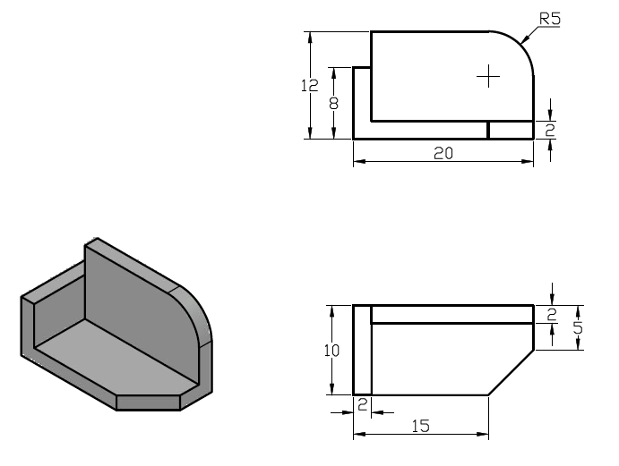
TOPIC 02 · HANDS-ON
2D Isometric Drawing
LAB 5
Use ISODRAFT to create a 2D isometric representation of the 3D object supplied in iso-object.dwg, switching isoplanes and drawing isocircles for the round features.
You'll produce
A flat isometric drawing of the 3D object — edges on the three isoplanes plus isocircle holes.
Commands: ISODRAFT, isoplanes (F5), ELLIPSE Isocircle, polar tracking
Files: iso-object.dwg
AutoCAD Masterclass · C391
© 2026 Tertiary Infotech Academy Pte Ltd
43

Slide 44
LAB 5 · VERIFY
2D Isometric Drawing
✅ Check your work
Each face lies on the correct isoplane (edges at 30°/90°/150°), the isocircles read as ellipses aligned to their faces, and the drawing matches the supplied object's proportions.
AutoCAD Masterclass · C391
© 2026 Tertiary Infotech Academy Pte Ltd
44

Slide 45
TOPIC RECAP
Recap — Technical Drawing with AutoCAD
Lab 2 — Creating Lines and Coordinates
The completed EX-1 profile drawn to size, matching the supplied solution DWG.
Lab 3 — Circles, Rectangles and Polygons
The completed EX-2 drawing with all holes, rectangles and polygons placed to the sheet dimensions.
1
2
Lab 4 — Polylines, Arcs, Ellipses and Splines
The completed EX-3 drawing with mixed line/arc geometry drawn as clean, connected objects.
Lab 5 — 2D Isometric Drawing
A flat isometric drawing of the 3D object — edges on the three isoplanes plus isocircle holes.
3
4
AutoCAD Masterclass · C391
© 2026 Tertiary Infotech Academy Pte Ltd
45

Slide 46
03
TOPIC 03
Modifying Objects
Move · Copy · Rotate · Offset · Mirror · Trim · Fillet · Arrays
AutoCAD Masterclass · C391
© 2026 Tertiary Infotech Academy Pte Ltd
46

Slide 47
TOPIC 03 · KEY CONCEPTS
Key Concepts — Modifying Objects
Relocate & duplicate
MOVE, COPY and ROTATE reposition objects from a base point to a second point or angle.
Offset & mirror
OFFSET creates parallel copies at a set distance; MIRROR reflects half a symmetric design.
1
2
Trim & extend
Quick and Standard modes cut objects back to, or extend them to meet, boundary edges.
Fillet & chamfer
FILLET rounds a corner with a radius; CHAMFER bevels it with distances or an angle.
3
4
Arrays
Rectangular, polar and path arrays distribute copies in rows/columns, around a centre, or along a curve.
Stretch, scale & explode
STRETCH lengthens with a crossing window; SCALE resizes about a base point; EXPLODE breaks compounds.
5
6
AutoCAD Masterclass · C391
© 2026 Tertiary Infotech Academy Pte Ltd
47

Slide 48
MODIFY
Relocating and Duplicating Objects
MOVE (M)
Select objects, pick a base point, then the second point — the objects relocate exactly.
COPY (CO)
Same flow as MOVE but leaves the original; Multiple mode places copy after copy.
1
2
ROTATE (RO)
Rotate about a base point by an absolute angle, or use Reference to match geometry.
OFFSET (O)
Creates concentric circles, parallel lines and parallel curves at a set distance.
3
4
AutoCAD Masterclass · C391
© 2026 Tertiary Infotech Academy Pte Ltd
48

Slide 49
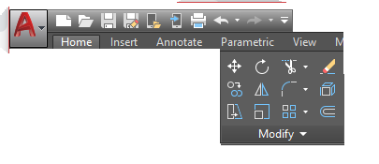
MODIFY
Offset in Practice
• Specify the offset distance, select the object, then click the side to offset to.
• Through mode offsets through a picked point instead of a distance.
• Offset polylines keep their corners; circles offset concentrically.
• Wall outlines, slots and rims are all one offset away from their centreline.
AutoCAD Masterclass · C391
© 2026 Tertiary Infotech Academy Pte Ltd
49

Slide 50
MODIFY
Mirror, Stretch and Scale
MIRROR (MI)
Draw half of a symmetric design, then reflect it across a two-point mirror line.
STRETCH (S)
Select with a crossing window; endpoints inside move, the rest stay anchored.
1
2
SCALE (SC)
Resize about a base point by factor — or Reference to hit an exact length.
Grips
Select first, then drag grips to stretch/move without any command.
3
4
AutoCAD Masterclass · C391
© 2026 Tertiary Infotech Academy Pte Ltd
50

Slide 51
MODIFY
Trim and Extend — Two Modes
Quick mode (default)
Standard mode
• Select the objects to be trimmed or extended, one by one or by dragging
• All visible geometry acts as the cutting/boundary edge
• Fastest for everyday cleanup
• First select boundary edges, press Enter, then select objects to trim/extend
• Press Enter at the first prompt to make everything a boundary
• Precise control for crowded drawings
AutoCAD Masterclass · C391
© 2026 Tertiary Infotech Academy Pte Ltd
51

Slide 52
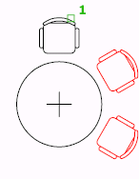
MODIFY
Arrays — Rectangular, Polar and Path
• ARRAY creates copies arranged in a pattern — associative by default.
• Rectangular: rows, columns and levels with set spacing.
• Polar: evenly distributes copies around a centre point or axis.
• Path: distributes copies along a line, polyline or curve.
AutoCAD Masterclass · C391
© 2026 Tertiary Infotech Academy Pte Ltd
52

Slide 53
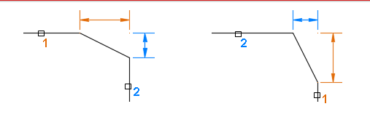
MODIFY
Fillet and Chamfer
• FILLET rounds the corner between two objects with a set radius.
• Enter r (Radius) first to change the current fillet radius.
• CHAMFER bevels a corner using two distances or a distance and angle.
• Radius 0 / distance 0 are quick ways to square off a corner exactly.
AutoCAD Masterclass · C391
© 2026 Tertiary Infotech Academy Pte Ltd
53

Slide 54
MODIFY
Erase, Explode, Break, Divide and Measure
ERASE (E)
Remove selected objects — or select first and press Delete.
EXPLODE (X)
Break a compound object (polyline, block, array) into components.
1
2
BREAK / Break at Point
Split lines, open polylines and arcs at one or two points.
DIVIDE · MEASURE
Place point nodes at equal counts (DIVIDE) or set intervals (MEASURE).
3
4
AutoCAD Masterclass · C391
© 2026 Tertiary Infotech Academy Pte Ltd
54

Slide 55
WHAT YOU'LL DO
Hands-On Labs — Modifying Objects
Lab 6
Lab 7
Lab 8
• Move, Copy, Rotate and Offset
• Trim, Extend, Fillet and Chamfer
• Mirror, Stretch, Scale and Arrays
AutoCAD Masterclass · C391
© 2026 Tertiary Infotech Academy Pte Ltd
55

Slide 56
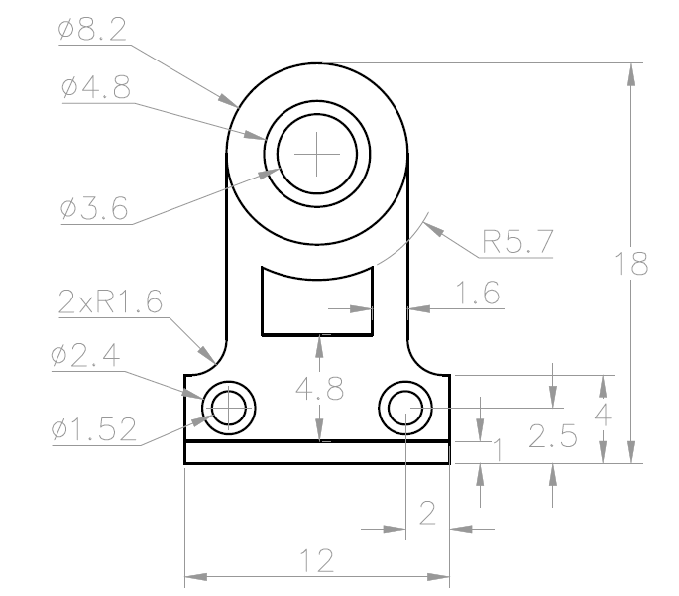
TOPIC 03 · HANDS-ON
Move, Copy, Rotate and Offset
LAB 6
Build practice drawing EX-4 by drawing one feature and then positioning the rest with MOVE, COPY (multiple), ROTATE with reference angle and OFFSET for the parallel profiles.
You'll produce
The completed EX-4 drawing produced with modify commands rather than re-drawing each feature.
Commands: MOVE, COPY (Multiple/Array), ROTATE (Reference), OFFSET
Files: ex4.dwg
AutoCAD Masterclass · C391
© 2026 Tertiary Infotech Academy Pte Ltd
56

Slide 57
LAB 6 · VERIFY
Move, Copy, Rotate and Offset
✅ Check your work
Feature spacings measure correct with DIST, offsets are at the specified distances, and the rotated feature sits at exactly the sheet's angle.
AutoCAD Masterclass · C391
© 2026 Tertiary Infotech Academy Pte Ltd
57

Slide 58
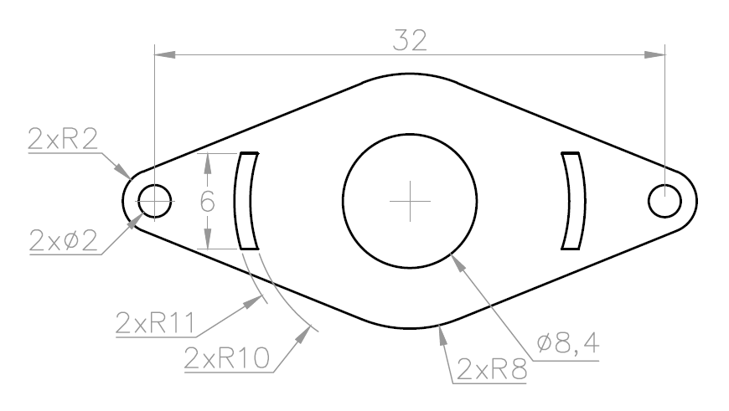
TOPIC 03 · HANDS-ON
Trim, Extend, Fillet and Chamfer
LAB 7
Complete practice drawing EX-5 by trimming overlapping construction geometry, extending short edges to their boundaries, and finishing corners with fillets and chamfers.
You'll produce
A clean EX-5 profile with every corner finished exactly as dimensioned on the sheet.
Commands: TRIM (Quick/Standard), EXTEND, FILLET, CHAMFER, BREAK
Files: ex5.dwg
AutoCAD Masterclass · C391
© 2026 Tertiary Infotech Academy Pte Ltd
58

Slide 59
LAB 7 · VERIFY
Trim, Extend, Fillet and Chamfer
✅ Check your work
No overshooting or dangling segments remain (zoom around the whole profile), and every fillet radius / chamfer distance matches the drawing sheet.
AutoCAD Masterclass · C391
© 2026 Tertiary Infotech Academy Pte Ltd
59

Slide 60
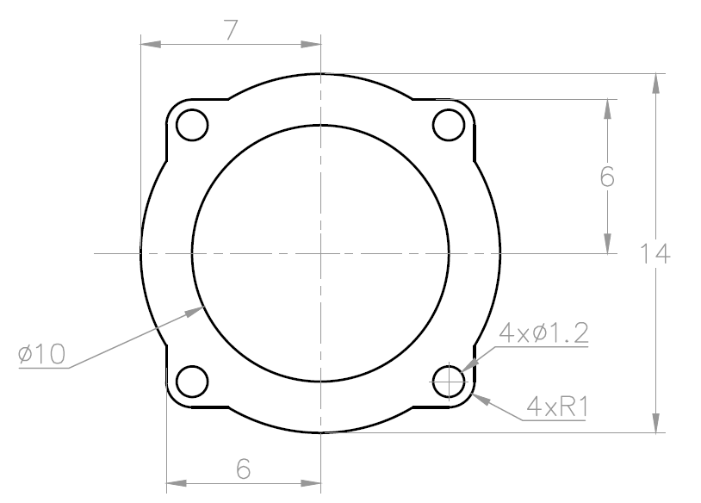
TOPIC 03 · HANDS-ON
Mirror, Stretch, Scale and Arrays
LAB 8
Produce practice drawing EX-6 with mirror, stretch, scale and arrays, then inspect the supplied sawblade drawing to reverse-engineer a production polar-array pattern.
You'll produce
The completed EX-6 drawing plus a verified sawblade polar array with the correct centre, item count, fill angle and associative state.
Commands: MIRROR, STRETCH (crossing window), SCALE (Reference), ARRAYRECT, ARRAYPOLAR
Files: ex6.dwg
AutoCAD Masterclass · C391
© 2026 Tertiary Infotech Academy Pte Ltd
60

Slide 61
LAB 8 · VERIFY
Mirror, Stretch, Scale and Arrays
✅ Check your work
The two halves are symmetric, array counts and spacings match the sheet, the slot length is correct, and you can explain the four defining properties of the sawblade polar array.
AutoCAD Masterclass · C391
© 2026 Tertiary Infotech Academy Pte Ltd
61

Slide 62
TOPIC RECAP
Recap — Modifying Objects
Lab 6 — Move, Copy, Rotate and Offset
The completed EX-4 drawing produced with modify commands rather than re-drawing each feature.
1
Lab 7 — Trim, Extend, Fillet and Chamfer
A clean EX-5 profile with every corner finished exactly as dimensioned on the sheet.
2
Lab 8 — Mirror, Stretch, Scale and Arrays
The completed EX-6 drawing plus a verified sawblade polar array with the correct centre, item count, fill angle and associative state.
3
AutoCAD Masterclass · C391
© 2026 Tertiary Infotech Academy Pte Ltd
62

Slide 63
04
TOPIC 04
Organizing Objects
Object Properties · Layers · Blocks, Attributes & Reusable Content
AutoCAD Masterclass · C391
© 2026 Tertiary Infotech Academy Pte Ltd
63

Slide 64
TOPIC 04 · KEY CONCEPTS
Key Concepts — Organizing Objects
Object properties
Colour, linetype and lineweight — set ByLayer and inspected in the Properties palette (PR).
Layers
The primary method of organising a drawing by function; control on/off, freeze/thaw, lock and plot.
1
2
Grips
Multi-functional grips stretch, move, rotate, scale and copy objects without typing a command.
Hide & isolate
Temporarily isolate the objects you are working on and hide the rest of the drawing.
3
4
Blocks & attributes
Blocks are reusable symbols; attributes attach part numbers and data — the basis of part lists.
External references
Xrefs attach another drawing (or PDF underlay) so teams share one live reference file.
5
6
AutoCAD Masterclass · C391
© 2026 Tertiary Infotech Academy Pte Ltd
64

Slide 65
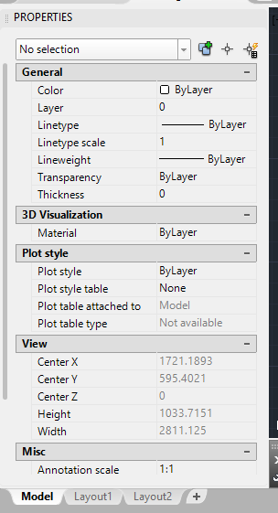
PROPERTIES
Object Properties and the Properties Palette
• The Home tab's Layers and Properties panels set the most common properties.
• The Properties palette (PR / Ctrl+1) is the complete list for any selection.
• With nothing selected it shows — and sets — the current defaults.
• Keep colour, linetype and lineweight ByLayer so layers stay in control.
AutoCAD Masterclass · C391
© 2026 Tertiary Infotech Academy Pte Ltd
65

Slide 66
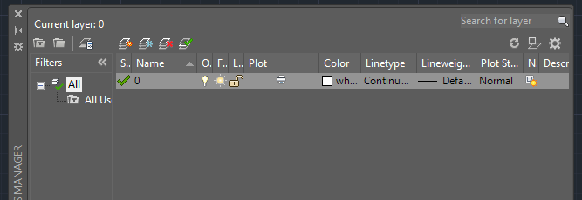
LAYERS
Layers — Organising Every Drawing
• Layers organise objects by function: outlines, hidden lines, centrelines, text, dimensions.
• The Layer Properties Manager creates layers and sets colour, linetype, lineweight and plot.
• All new objects are drawn on the current layer (green tick).
• Off vs freeze: frozen layers are skipped entirely and speed up big drawings; lock to view but not edit.
AutoCAD Masterclass · C391
© 2026 Tertiary Infotech Academy Pte Ltd
66

Slide 67
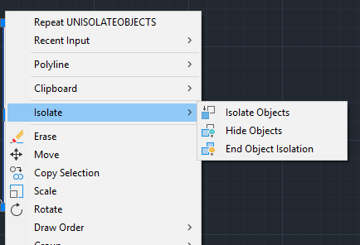
FOCUS
Hide and Isolate Objects
• Isolate Selected Objects hides everything except your selection.
• Hide Selected Objects removes just the selection from view.
• Both are temporary view states — End Object Isolation restores all.
• Right-click menu or the status-bar lightbulb icon controls isolation.
AutoCAD Masterclass · C391
© 2026 Tertiary Infotech Academy Pte Ltd
67

Slide 68
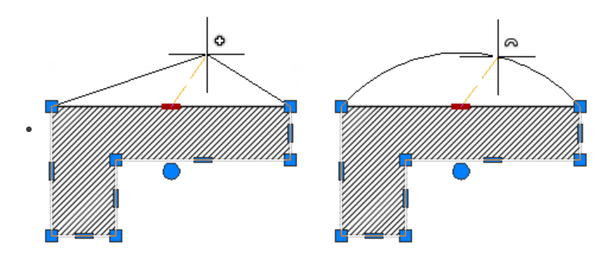
DIRECT EDITING
Multi-Functional Grips
• Select with no command running and grips appear at defining points.
• Drag a grip to stretch; press Enter to cycle Stretch → Move → Rotate → Scale → Mirror.
• Hover a grip for its multi-function menu (e.g. add vertex, convert to arc).
• Lines, polylines, arcs, dimensions and viewports all expose smart grips.
AutoCAD Masterclass · C391
© 2026 Tertiary Infotech Academy Pte Ltd
68

Slide 69
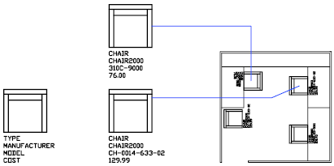
REUSABLE CONTENT
Blocks, Dynamic Blocks and Attributes
• BLOCK combines objects into a named, reusable symbol inserted with INSERT.
• Dynamic blocks add parameters and actions — one block, many sizes/states.
• Attributes attach data to a block: part numbers, descriptions, quantities.
• ATTDEF defines the tag, prompt and default; DATAEXTRACTION turns attributes into part-list tables.
AutoCAD Masterclass · C391
© 2026 Tertiary Infotech Academy Pte Ltd
69

Slide 70
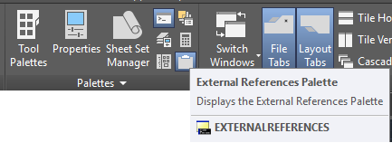
REUSABLE CONTENT
External References (Xrefs)
• An xref attaches another drawing file into the current drawing — live, not copied.
• The External References palette organises, reloads and repaths every reference.
• Teams share one title block or site plan; edits flow to every host on reload.
• PDFs and images attach the same way as underlays for tracing.
AutoCAD Masterclass · C391
© 2026 Tertiary Infotech Academy Pte Ltd
70

Slide 71
WHAT YOU'LL DO
Hands-On Labs — Organizing Objects
Labs 9–10
Lab 11
Lab 12
• Object Properties and Layers
• Grips, Hide and Isolate
• Blocks, Attributes and Part Lists
• External References and PDF Import
AutoCAD Masterclass · C391
© 2026 Tertiary Infotech Academy Pte Ltd
71

Slide 72
TOPIC 04 · HANDS-ON
Object Properties and Layers
LAB 9
Create a standards-based layer scheme in lab-table-lesson2.dwg, then audit the supplied office-plan-ground-floor.dwg to see how a larger architectural drawing separates systems.
You'll produce
A layered table drawing where every object is ByLayer, plus a five-layer audit of the office plan covering naming, colour, linetype, lineweight and plot state.
Commands: LAYER (LA), Properties palette (PR), Layer Walk, MATCHPROP, freeze/thaw, lock
Files: lab-table-lesson2.dwg
AutoCAD Masterclass · C391
© 2026 Tertiary Infotech Academy Pte Ltd
72

Slide 73
LAB 9 · VERIFY
Object Properties and Layers
✅ Check your work
Turning each layer off hides exactly its objects, everything in table-layers.dwg reports ByLayer, and the office-plan audit identifies five layers with their intended functions.
AutoCAD Masterclass · C391
© 2026 Tertiary Infotech Academy Pte Ltd
73

Slide 74
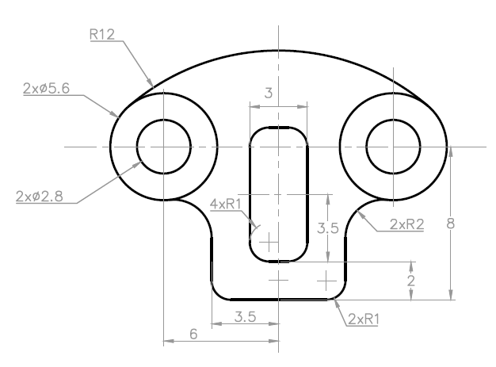
TOPIC 04 · HANDS-ON
Grips, Hide and Isolate
LAB 10
Use multi-functional grips on EX-7, then practise isolate, hide, select-similar and end-isolate in the denser new-office-design.dwg without losing or deleting objects.
You'll produce
An edited EX-7 layout plus a saved office-plan view in which the targeted object class was isolated, edited and fully restored.
Commands: Multi-functional grips, grip modes (Enter to cycle), Isolate/Hide Objects, Select Similar
Files: ex7.dwg
AutoCAD Masterclass · C391
© 2026 Tertiary Infotech Academy Pte Ltd
74

Slide 75
LAB 10 · VERIFY
Grips, Hide and Isolate
✅ Check your work
You can stretch, move, rotate and copy with grips alone; after UNISOLATEOBJECTS, the office drawing's object count and layer visibility match the starting state except for your saved edit.
AutoCAD Masterclass · C391
© 2026 Tertiary Infotech Academy Pte Ltd
75

Slide 76
TOPIC 04 · HANDS-ON
Blocks, Attributes and Part Lists
LAB 11
Inspect a reusable block library and a drawing containing dynamic blocks, then define a part-tag block with attributes and prepare its data for the part list.
You'll produce
A BALLOON block with PART_NO / DESC / QTY attributes, plus evidence that one library block and one dynamic-block state can be inserted and edited correctly.
Commands: BLOCK, WBLOCK, DesignCenter, ATTDEF, INSERT, ATTEDIT, dynamic-block grips, DATAEXTRACTION
Files: title-block.dwg
AutoCAD Masterclass · C391
© 2026 Tertiary Infotech Academy Pte Ltd
76

Slide 77
LAB 11 · VERIFY
Blocks, Attributes and Part Lists
✅ Check your work
The library block inserts at the correct scale, the dynamic state changes without exploding, and Data Extraction lists one row per BALLOON with the values you entered.
AutoCAD Masterclass · C391
© 2026 Tertiary Infotech Academy Pte Ltd
77

Slide 78
TOPIC 04 · HANDS-ON
External References and PDF Import
LAB 12
Repair and verify the relative Landscaping_REV1 Xref in the supplied office-layout host, then attach a title block and a PDF underlay and import vector geometry.
You'll produce
A host drawing whose landscaping Xref resolves from the lab folder, with an additional live title-block Xref and an imported PDF geometry sample.
Commands: XREF/ATTACH, External References palette, PDFATTACH, PDFIMPORT
Files: title-block.dwg
AutoCAD Masterclass · C391
© 2026 Tertiary Infotech Academy Pte Ltd
78

Slide 79
LAB 12 · VERIFY
External References and PDF Import
✅ Check your work
Both Xrefs show Loaded, Landscaping_REV1 uses a relative path and survives reopening the folder elsewhere, while PDFIMPORT produces editable AutoCAD objects from the underlay.
AutoCAD Masterclass · C391
© 2026 Tertiary Infotech Academy Pte Ltd
79

Slide 80
TOPIC RECAP
Recap — Organizing Objects
Lab 9 — Object Properties and Layers
A layered table drawing where every object is ByLayer, plus a five-layer audit of the office plan covering naming, colour, linetype, lineweight and plot state.
Lab 10 — Grips, Hide and Isolate
An edited EX-7 layout plus a saved office-plan view in which the targeted object class was isolated, edited and fully restored.
1
2
Lab 11 — Blocks, Attributes and Part Lists
A BALLOON block with PART_NO / DESC / QTY attributes, plus evidence that one library block and one dynamic-block state can be inserted and edited correctly.
Lab 12 — External References and PDF Import
A host drawing whose landscaping Xref resolves from the lab folder, with an additional live title-block Xref and an imported PDF geometry sample.
3
4
AutoCAD Masterclass · C391
© 2026 Tertiary Infotech Academy Pte Ltd
80

Slide 81
05
TOPIC 05
Design Documentation
Text · Dimensions · Tables & Part Lists · Layouts, Viewports & Plotting
AutoCAD Masterclass · C391
© 2026 Tertiary Infotech Academy Pte Ltd
81

Slide 82
TOPIC 05 · KEY CONCEPTS
Key Concepts — Design Documentation
Text & text styles
Single-line and multiline text; a text style controls font, height and justification centrally.
Dimensions
Linear, aligned, angular, radial, diameter, ordinate and arc-length dimensions annotate real sizes.
1
2
Dimension styles
A named collection of settings — arrowheads, text placement, tolerances — applied consistently.
Multileaders & clouds
Multileaders point notes at features; revision clouds flag changed areas for checking.
3
4
Tables & part lists
TABLE creates row/column data such as bills of materials extracted from block attributes.
Layouts & plotting
Scaled viewports on a titled layout sheet, printed with PLOT or published to PDF/DWF.
5
6
AutoCAD Masterclass · C391
© 2026 Tertiary Infotech Academy Pte Ltd
82

Slide 83
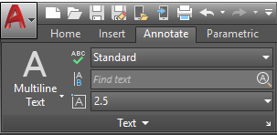
ANNOTATION
Text and Text Styles
• Multiline text (MTEXT) fills a bounding box; single-line text (TEXT) is quick labels.
• A text style names a collection of settings: font, height, spacing, justification.
• Create styles once (STYLE) and every note updates when the style changes.
• Annotative styles size text automatically to the viewport scale.
AutoCAD Masterclass · C391
© 2026 Tertiary Infotech Academy Pte Ltd
83

Slide 84
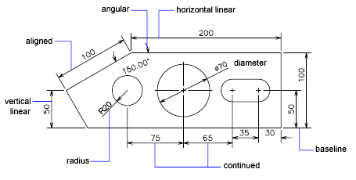
ANNOTATION
Dimensions — The Basic Types
• Linear and aligned dimensions measure edges; angular measures between lines.
• Radial and diameter dimensions measure arcs and circles, with centre marks.
• Arc-length and ordinate dimensions cover curved lengths and datum offsets.
• Continue chains dimensions end-to-end; Baseline stacks them from one datum.
AutoCAD Masterclass · C391
© 2026 Tertiary Infotech Academy Pte Ltd
84

Slide 85
ANNOTATION
Dimension Styles
What a style controls
Arrowheads, extension lines, text placement, units and tolerances — consistently.
Create
DIMSTYLE → New: name it, set fit, text height and precision for your standard.
1
2
Apply
Set the style current before dimensioning; existing dimensions can be updated.
House rule
Never override individual dimension text — fix the style instead.
3
4
AutoCAD Masterclass · C391
© 2026 Tertiary Infotech Academy Pte Ltd
85

Slide 86
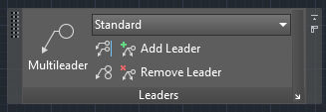
ANNOTATION
Multileaders and Revision Clouds
• A multileader is an arrowhead, landing line and note text (or block) in one object.
• MLEADER places it; add/remove leader lines and align multiple leaders neatly.
• Revision clouds flag changed areas for checking and approval.
• Draw a cloud by dragging, corner points — or convert an existing closed object.
AutoCAD Masterclass · C391
© 2026 Tertiary Infotech Academy Pte Ltd
86

Slide 87
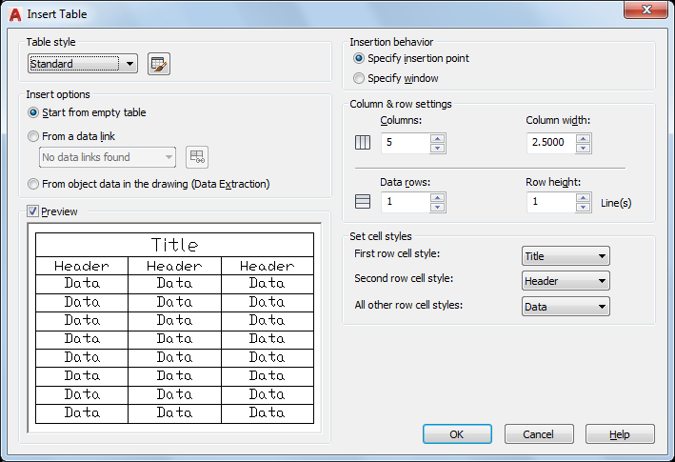
PART LISTS
Tables and Part Lists
• TABLE creates a compound object of rows and columns from a table style.
• Type into cells like a spreadsheet; formulas and fields are supported.
• DATAEXTRACTION fills a table from block attributes — the bill of materials.
• Tables can link to external Excel data and update both ways.
AutoCAD Masterclass · C391
© 2026 Tertiary Infotech Academy Pte Ltd
87

Slide 88
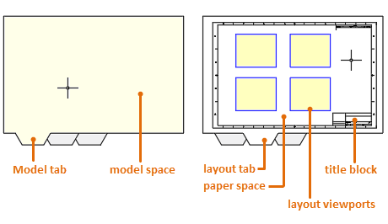
OUTPUT
Layouts and Viewports
• A layout is the 2D sheet environment: title block, viewports, annotation.
• MVIEW creates layout viewports — windows into model space.
• Set each viewport's scale exactly (e.g. 1:20), then lock it against accidental zooming.
• One model, many sheets: each layout composes its own views and scales.
AutoCAD Masterclass · C391
© 2026 Tertiary Infotech Academy Pte Ltd
88

Slide 89
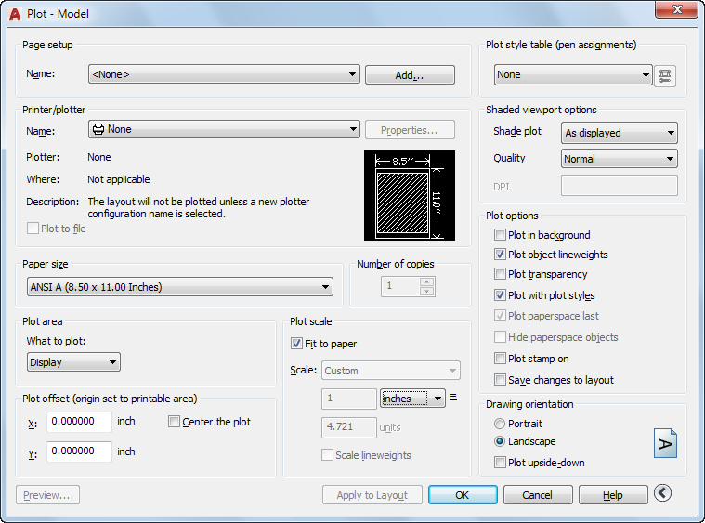
OUTPUT
Plotting and Printing
• Plot from the layout: choose plotter, paper size, plot area, scale and orientation.
• DWG To PDF.pc3 publishes the standard submission PDF.
• Page setups save the configuration per layout and import between drawings.
• Preview before plotting — check lineweights, scale and the full sheet.
AutoCAD Masterclass · C391
© 2026 Tertiary Infotech Academy Pte Ltd
89

Slide 90
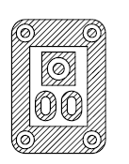
DETAIL
Hatching and Gradients
• HATCH fills enclosed areas with patterns (ANSI31 for sections), solids or gradients.
• Pick an internal point — island detection keeps text and holes clear.
• Scale and angle make adjacent parts read distinctly in section views.
• HATCHEDIT changes an existing hatch; hatches stay associative to their boundary.
AutoCAD Masterclass · C391
© 2026 Tertiary Infotech Academy Pte Ltd
90

Slide 91
WHAT YOU'LL DO
Hands-On Labs — Design Documentation
Labs 13–14
Lab 15
Lab 16
• Text and Text Styles
• Dimensions, Multileaders and Part-List Tables
• Hatching and Detail Finishing
• Layouts, Viewports and Plotting
AutoCAD Masterclass · C391
© 2026 Tertiary Infotech Academy Pte Ltd
91

Slide 92
TOPIC 05 · HANDS-ON
Text and Text Styles
LAB 13
Annotate the layered table drawing with single-line and multiline text, create and apply text styles for titles and notes, and fill in the title-block fields.
You'll produce
An annotated drawing with consistent TITLE and NOTES text styles and a completed title block.
Commands: TEXT, MTEXT, STYLE, annotative text, SPELL
Files: lab-table-lesson2.dwg
AutoCAD Masterclass · C391
© 2026 Tertiary Infotech Academy Pte Ltd
92

Slide 93
LAB 13 · VERIFY
Text and Text Styles
✅ Check your work
All annotation uses your named styles (none on Standard), the title block is complete, and changing the NOTES style font updates every note at once.
AutoCAD Masterclass · C391
© 2026 Tertiary Infotech Academy Pte Ltd
93

Slide 94
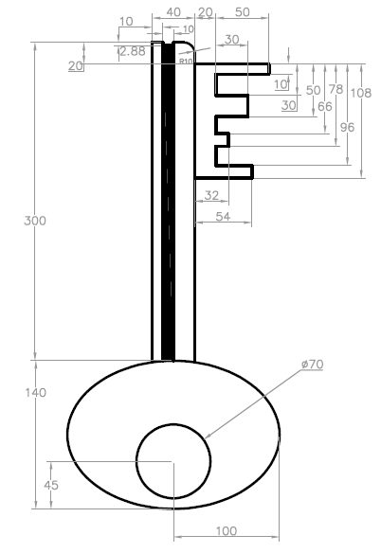
TOPIC 05 · HANDS-ON
Dimensions, Multileaders and Part-List Tables
LAB 14
Fully dimension practice drawing EX-8 with a metric dimension style — linear, aligned, radial, diameter, angular, continue and baseline — add multileader callouts, and create the part-list table from the Lab 11 balloon attributes.
You'll produce
A fully dimensioned EX-8 sheet with leader notes and a parts table (part no · description · qty).
Commands: DIMSTYLE, DIM, DLI/DAL/DRA/DDI/DAN, DCO/DBA, MLEADER, TABLE, DATAEXTRACTION
Files: ex8.dwg
AutoCAD Masterclass · C391
© 2026 Tertiary Infotech Academy Pte Ltd
94

Slide 95
LAB 14 · VERIFY
Dimensions, Multileaders and Part-List Tables
✅ Check your work
Every dimension on the EX-8 sheet is reproduced with the MECH-25 style (no overridden text), leaders land neatly, and the table rows match the balloons one-for-one.
AutoCAD Masterclass · C391
© 2026 Tertiary Infotech Academy Pte Ltd
95

Slide 96
TOPIC 05 · HANDS-ON
Hatching and Detail Finishing
LAB 15
Apply section hatching with controlled boundaries and islands, then compare two supplied landscaping revisions and mark the changed area with a revision cloud and note.
You'll produce
A correctly hatched section view plus a documented landscaping revision showing the changed geometry, revision cloud and concise change note.
Commands: HATCH, gradient fills, boundary/island detection, HATCHEDIT, DWG Compare, REVCLOUD, MLEADER
Files: ex3.dwg
AutoCAD Masterclass · C391
© 2026 Tertiary Infotech Academy Pte Ltd
96

Slide 97
LAB 15 · VERIFY
Hatching and Detail Finishing
✅ Check your work
Hatches do not bleed, adjacent parts use distinct angles, islands remain clear, and the landscaping review identifies every revision with one cloud and one readable note.
AutoCAD Masterclass · C391
© 2026 Tertiary Infotech Academy Pte Ltd
97

Slide 98
TOPIC 05 · HANDS-ON
Layouts, Viewports and Plotting
LAB 16
Audit the supplied new-office-layout.dwg, then compose an A3 layout with a title block, locked scaled viewports and a standards-compliant PDF plot.
You'll produce
A print-ready A3 office layout with two locked viewports, completed title information, verified lineweights and a plotted PDF.
Commands: LAYOUT, PAGESETUP, MVIEW, viewport scale/lock, PLOT, DWG to PDF.pc3
Files: title-block.dwg
AutoCAD Masterclass · C391
© 2026 Tertiary Infotech Academy Pte Ltd
98

Slide 99
LAB 16 · VERIFY
Layouts, Viewports and Plotting
✅ Check your work
Both viewports report their exact scales in the status bar and cannot be zoomed when locked, and the plotted PDF shows the complete titled sheet at A3.
AutoCAD Masterclass · C391
© 2026 Tertiary Infotech Academy Pte Ltd
99

Slide 100
TOPIC RECAP
Recap — Design Documentation
Lab 13 — Text and Text Styles
An annotated drawing with consistent TITLE and NOTES text styles and a completed title block.
Lab 14 — Dimensions, Multileaders and Part-List Tables
A fully dimensioned EX-8 sheet with leader notes and a parts table (part no · description · qty).
1
2
Lab 15 — Hatching and Detail Finishing
A correctly hatched section view plus a documented landscaping revision showing the changed geometry, revision cloud and concise change note.
Lab 16 — Layouts, Viewports and Plotting
A print-ready A3 office layout with two locked viewports, completed title information, verified lineweights and a plotted PDF.
3
4
AutoCAD Masterclass · C391
© 2026 Tertiary Infotech Academy Pte Ltd
100

Slide 101
WRAP-UP
Course Summary & Next Steps
AutoCAD Masterclass · C391
© 2026 Tertiary Infotech Academy Pte Ltd
101

Slide 102
COURSE RECAP
What You Achieved
Getting started
Navigated the AutoCAD UI, workspaces, units and precision drafting aids.
Technical drawing
Produced accurate 2D drawings and isometric views from dimensioned sheets.
1
2
Modifying objects
Built designs efficiently with move/copy, offset, trim, fillet and arrays.
Organizing objects
Structured drawings with layers, blocks, attributes and external references.
3
4
Design documentation
Dimensioned, annotated, tabulated part lists and plotted submission-ready sheets.
5
AutoCAD Masterclass · C391
© 2026 Tertiary Infotech Academy Pte Ltd
102

Slide 103
KEEP LEARNING
Recommended Next Courses
Architecture Drawing with Revit
Tertiary Infotech Academy
Product Design with Fusion 360
Tertiary Infotech Academy
1
2
AutoCAD Civil 3D for Infrastructure Design
Tertiary Infotech Academy
Technical Drawing with AutoCAD Mechanical
Tertiary Infotech Academy
3
4
Technical Drawing with AutoCAD Electrical
Tertiary Infotech Academy
5
AutoCAD Masterclass · C391
© 2026 Tertiary Infotech Academy Pte Ltd
103

Slide 104
WE'RE HERE TO HELP
Support
• If you have any enquiries during and after the class, contact us:
• Email: enquiry@tertiaryinfotech.com
• Tel: +65 6100 0613
• Website: www.tertiarycourses.com.sg
AutoCAD Masterclass · C391
© 2026 Tertiary Infotech Academy Pte Ltd
104

Slide 105
BEFORE YOU LEAVE
Course Feedback
• Please complete the course feedback form on the LMS — it helps us improve the course.
• Your certificate of completion is issued on the LMS after the course.
• Portal: https://lms-tms.tertiaryinfotech.com
AutoCAD Masterclass · C391
© 2026 Tertiary Infotech Academy Pte Ltd
105

Slide 106
HAPPY DRAFTING
Thank You!
You are now ready to read, produce and document technical drawings with AutoCAD.
AutoCAD Masterclass · C391
© 2026 Tertiary Infotech Academy Pte Ltd
106

